Slide 1

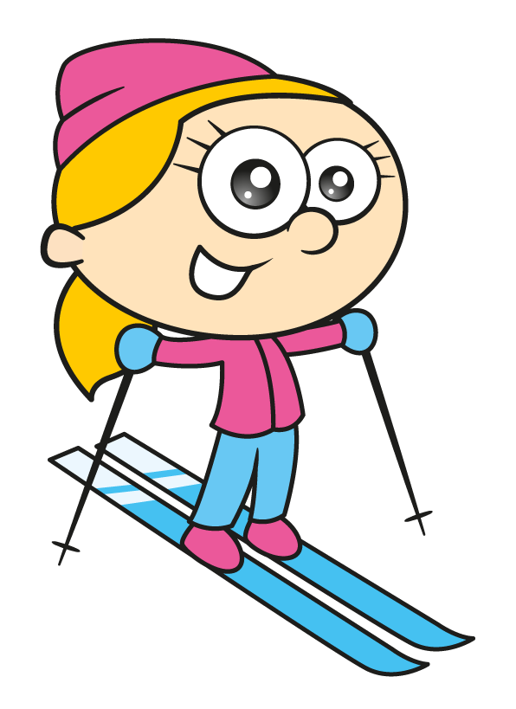
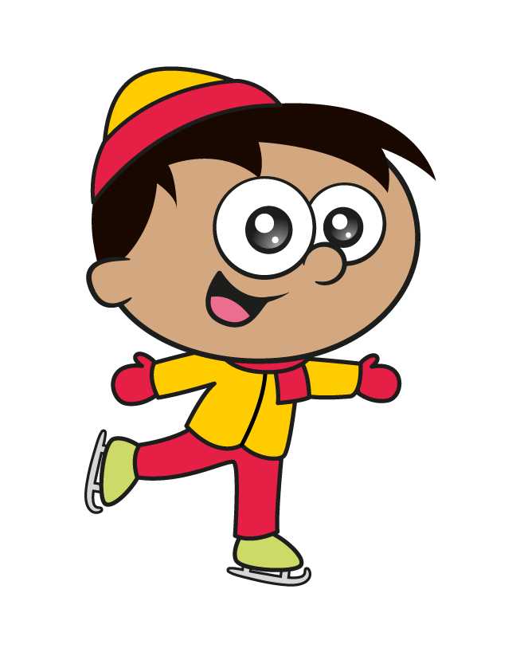
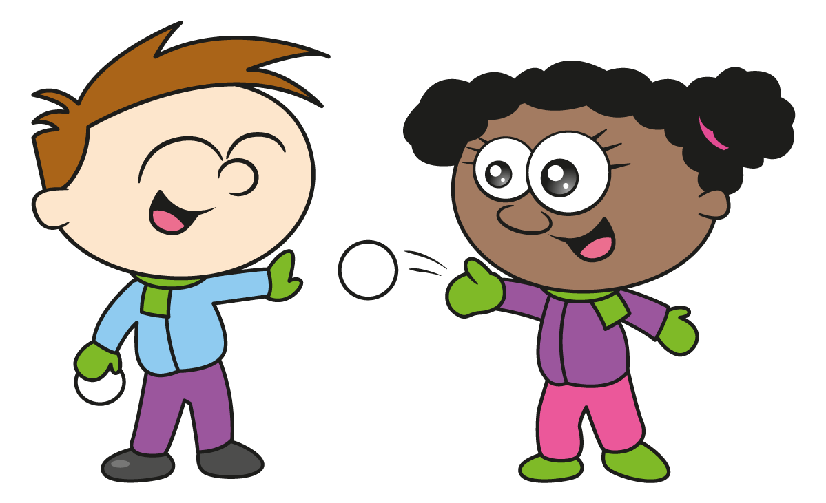
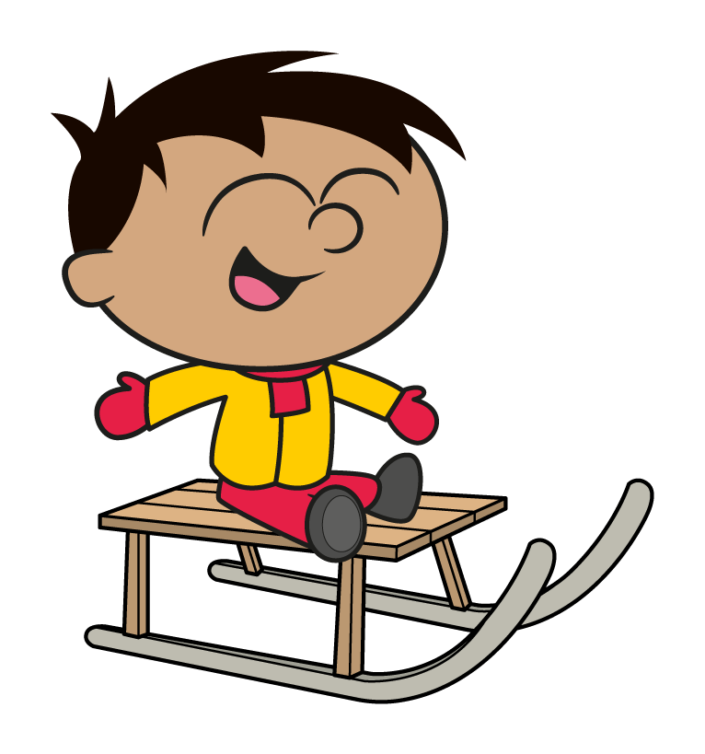


Slide 2

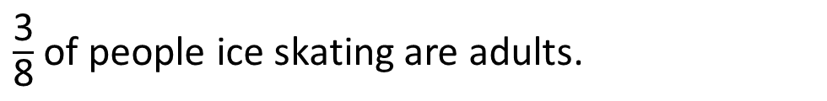
A number of adults and children are ice skating at the White Rose ice rink.
$\frac{\text{3}}{\text{8}}$ of people ice skating are adults.
The rest are children.
There are 24 more children ice skating than adults.
How many people are ice skating in total?
Have a think

Slide 3
There are 24 more children ice skating than adults.
Adults
12
12
24
12
?
Children
12
12
12
12
12
96 people were ice skating.

Slide 4



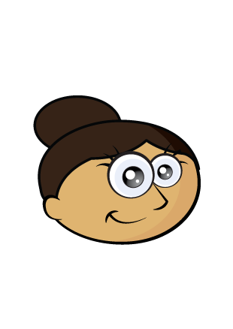
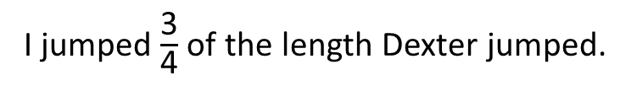
Eva, Mo, Dexter and Dora are ski jumping.
Can you work out how far each person jumped?
I jumped $\frac{\text{3}}{\text{4}}$ of the length Dexter jumped.
Have a think
Eva
I jumped 36 metres less than Dexter.
Mo
I jumped the equivalent of 6³ in metres.
Dexter
I jumped 5,300 cm further than Eva.
Dora

Slide 5
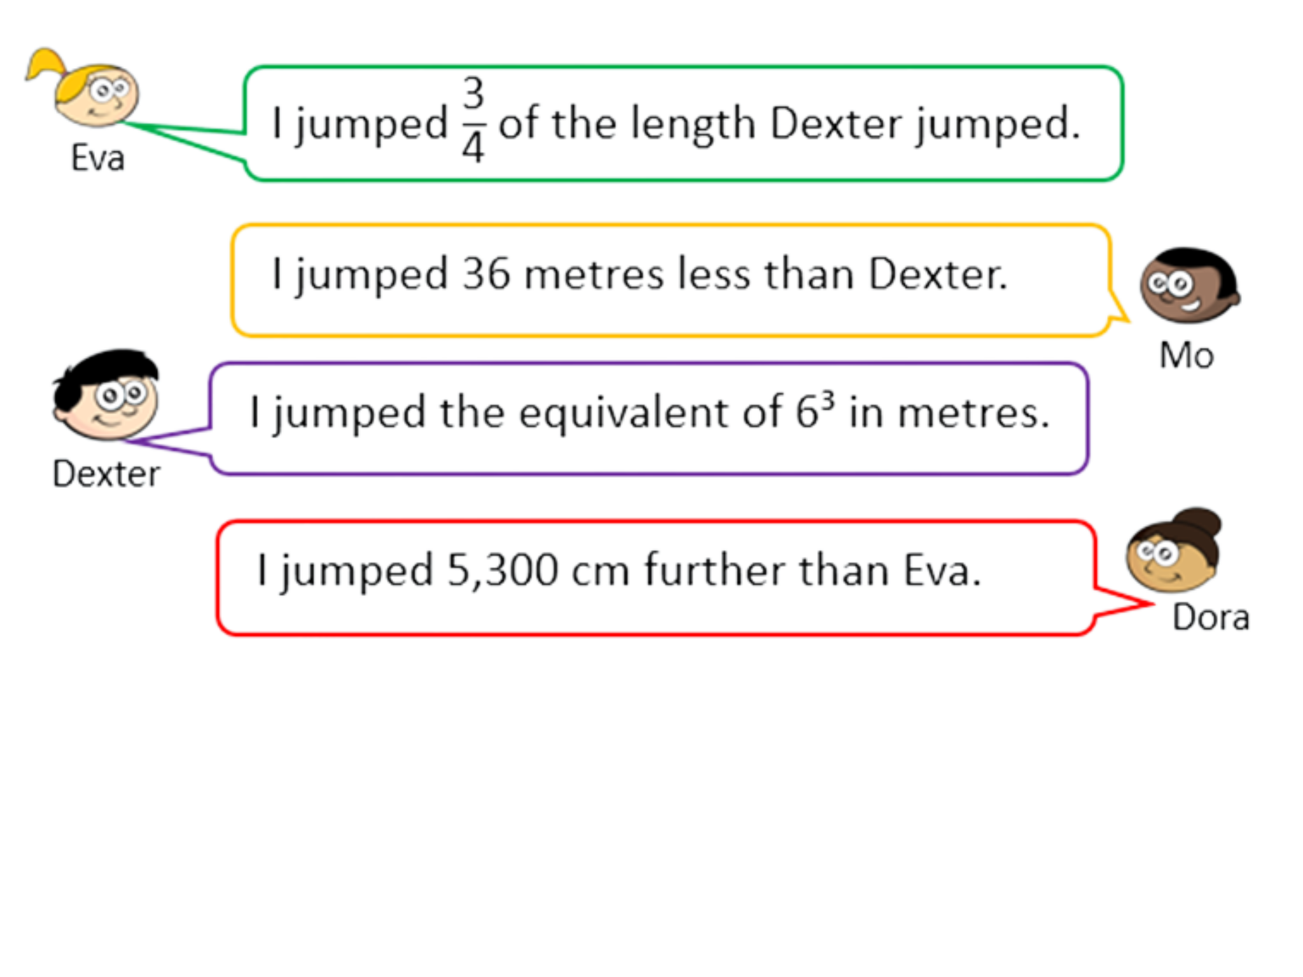

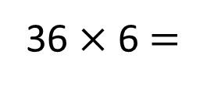
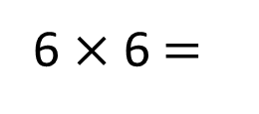
Dexter jumped 216 metres.
6 $×$ 6 $=$
36
36 $×$ 6 $=$
216

Slide 6
Dexter jumped 216 metres.
4 | 2 | 1 | 6
0
5
4
1
216
54
54
54
?
Eva jumped 162 metres.

Slide 7
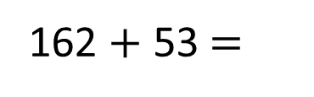
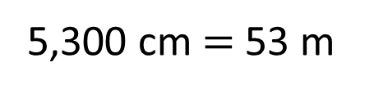
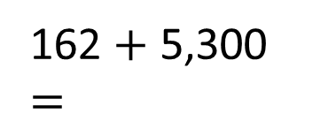
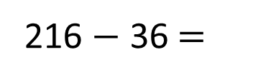
Dexter jumped 216 metres.
Eva jumped 162 metres.
Mo jumped 180 metres.
Dora jumped 215 metres.
216 $−$ 36 $=$
180
Who jumped the furthest?
By how many metres?
What is the difference between the longest and shortest jump?
We have a late entry! Annie’s jump becomes the third longest jump. What could the distance be?
162 $+$ 53 $=$
5,300 cm $=$ 53 m
162 $+$ 5,300 $=$
215

Slide 8
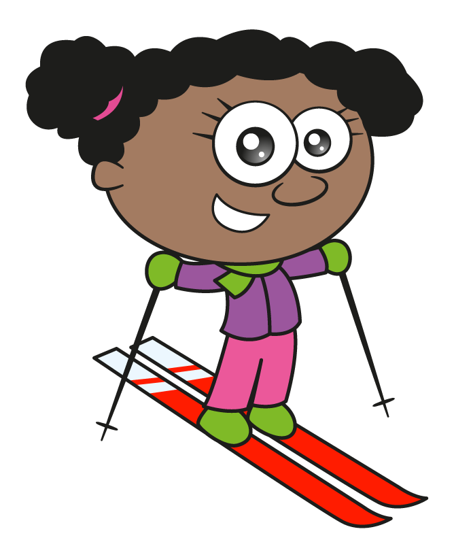
On a winter school trip, children are allowed to choose 2 of the following activities to try.
Sledging
Snowboarding
Skiing
Tobogganing
How many different possible combinations are there?
Have a think

Slide 9
There are 6 possible combinations.
On a winter school trip, children are allowed to choose 2 of the following activities to try.
Ice canoeing has now become a possible activity!
How many different possible combinations are there now?
Have a think
Sledging
Snowboarding
Skiing
Tobogganing
✓
✓
✓
✓
✓
✓
✓
✓
✓
✓
✓
✓

Slide 10
Sledging
Snowboarding
Skiing
Tobogganing
Ice canoeing
✓
✓
✓
✓
✓
✓
✓
✓
✓
✓
✓
✓
✓
✓
✓
✓
✓
✓
✓
✓
There are 10 possible combinations.

Slide 11
4 activities $=$ 6 combinations
5 activities $=$ 10 combinations
6 activities $=$ ? combinations
7 activities $=$ ? combinations
10 activities $=$ ? combinations
20 activities $=$ ? combinations

