Slide 1

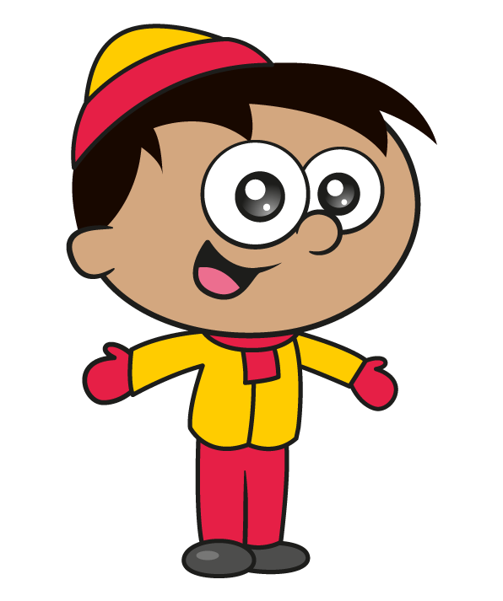

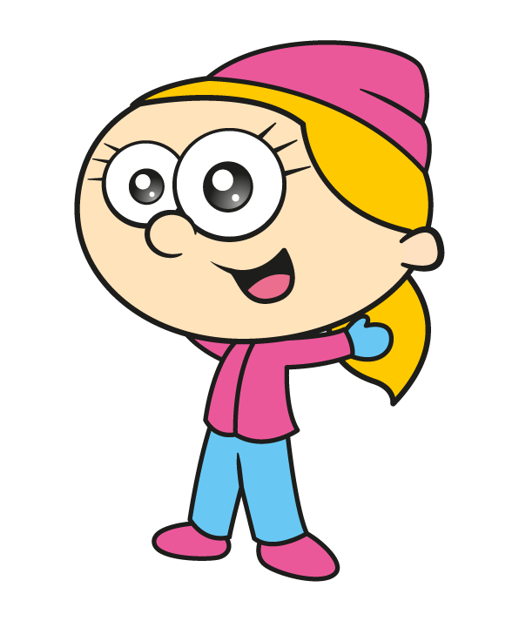
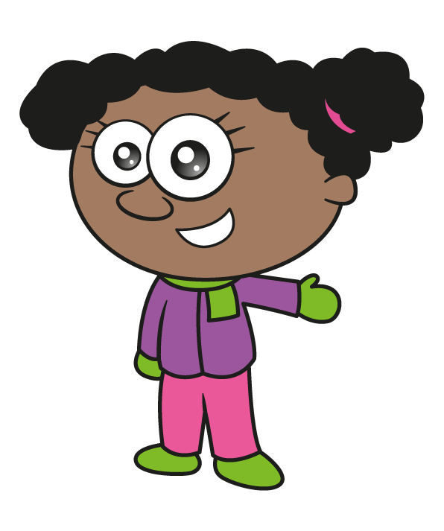

Slide 2

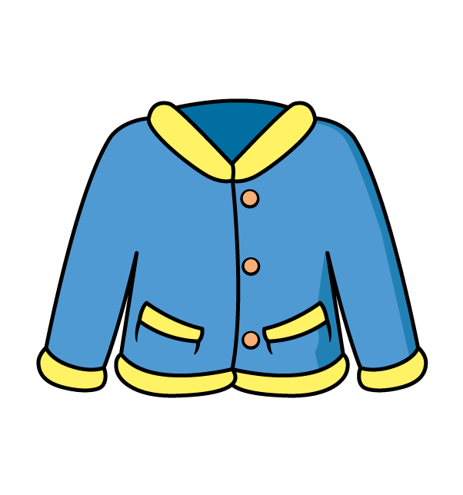


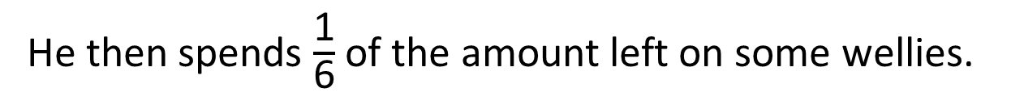

Tommy has £210
He spends $\frac{\text{1}}{\text{5}}$ of the money on a new winter jacket.
He then spends $\frac{\text{1}}{\text{6}}$ of the amount left on some wellies.
Which item costs the most and by how much?
Have a think

Slide 3
Tommy has £210
He spends $\frac{\text{1}}{\text{5}}$ of the money on a new winter jacket.
£210
5 | 2 | 1 | 0
?
0
4
2
Tommy spends £42 on a new jacket.

Slide 4
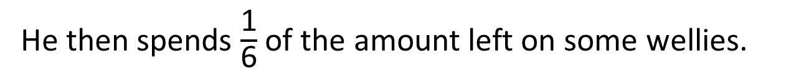
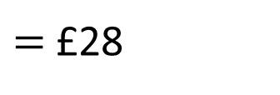
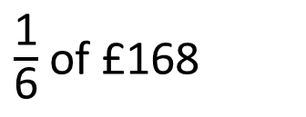
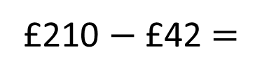
He then spends $\frac{\text{1}}{\text{6}}$ of the amount left on some wellies.
£210 $−$ £42 $=$
£168
6 | 1 | 6 | 8
0
2
8
$\frac{\text{1}}{\text{6}}$ of £168
4
$=$ £28
£168
?

Slide 5
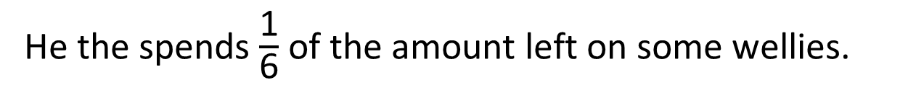
Tommy has £210
He spends $\frac{\text{1}}{\text{5}}$ of the money on a new winter jacket.
£42
He the spends $\frac{\text{1}}{\text{6}}$ of the amount left on some wellies.
£28
Which item costs the most and by how much?
The winter jacket.
£14

Slide 6

Mr Rose is knitting scarves.
He makes panels of different colours.
Each panel is 16 cm long and 8 cm wide.
What is the area of a scarf with 6 panels?
16 cm
8 cm
Have a think

Slide 7






Mr Rose is knitting scarves.
He makes panels of different colours.
Each panel is 16 cm long and 8 cm wide.
768 cm²
What is the area of a scarf with 6 panels?
16 cm
8 cm
16 $×$ 6 $×$ 8
16 $×$ 8 $=$
80 $+$ 48 $=$
128 cm²
128 $×$ 6
130 $×$ 6 $=$
780
10
6
780 $−$ (2$×$ 6) $=$
768

Slide 8
Mr Rose is knitting scarves.
He makes panels of different colours.
Each panel is 16 cm long and 8 cm wide.
What is the area of a scarf with 6 panels?
16 cm
8 cm
Could Mr Rose make a scarf that has an odd number as the area?
What would the length and width of the panels have to be in order to make a scarf with an odd area?
It must be…
It could be…
It can’t be…

Slide 9


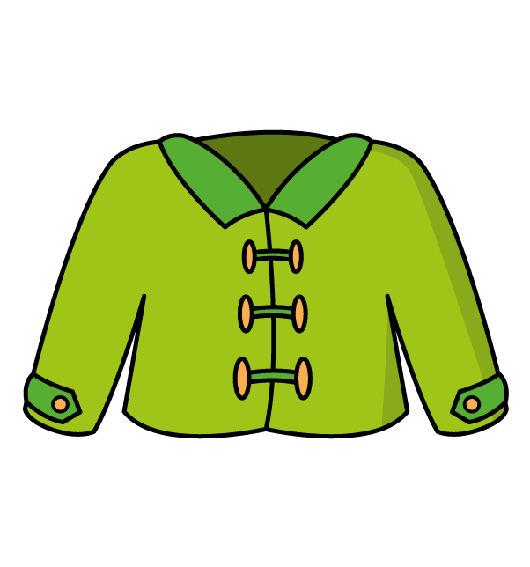








Find the value of the hat, jacket and scarf.
Have a think
$$×$$
$$=$$
180
$$+$$
$$+$$
$$=$$
36
$$×$$
$$×$$
$$=$$
3,600

Slide 10
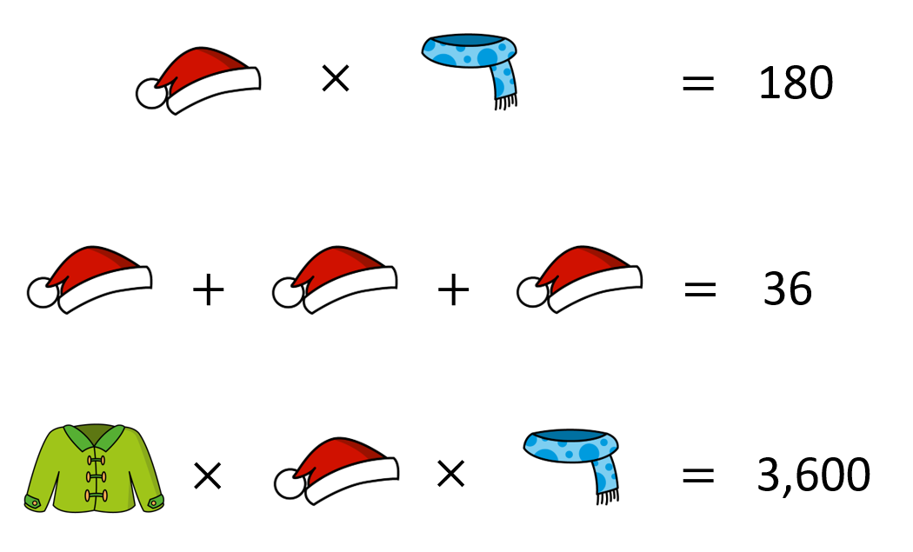
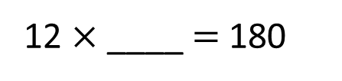



$$=$$
12
$$=$$
15
$$=$$
12 | 1 | 8 | 0
0
1
5
12 $×$ ____ $=$ 180
6

Slide 11

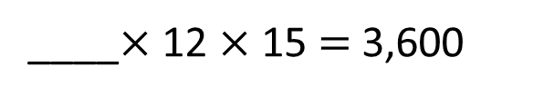
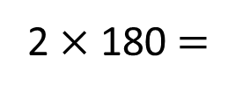
$$=$$
12
$$=$$
15
$$=$$
20
____$×$ 12 $×$ 15 $=$ 3,600
20
____$×$ 180$=$ 3,600
2$×$ 180 $=$
360

Slide 12




Have a think
$$=$$
12
$$=$$
15
$$=$$
20
?
$$+$$
$$×$$
$$=$$
245

Slide 13
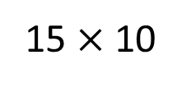
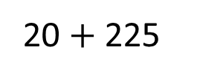
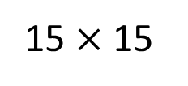
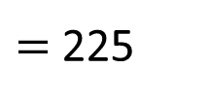
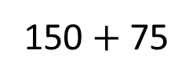



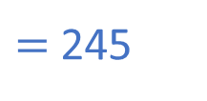
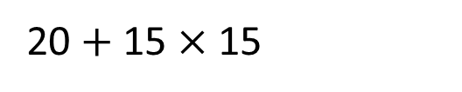
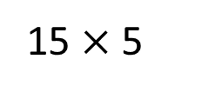
20 $+$ 15 $×$ 15
brackets
indices
$$=$$
12
15 $×$ 15
$=$ 225
$÷$ $×$
$$=$$
15
$$+$$
15 $×$ 5
15 $×$ 10
$+$ $−$
150 $+$ 75
$$=$$
20
20 $+$ 225
$=$ 245
?
$$+$$
$$×$$
$$=$$
245

