Slide 1







Slide 2


Dora catches
15 snowflakes.
There are 3 different types of snowflakes.
An odd amount of each snowflake lands on Dora’s hand.
How many different possible combinations are there?
Have a think

Slide 3

1, 3, 5, 7, 9, 11, 13
1
1
13
1
3
11
1
5
9
What if Dora caught
17 snowflakes?
What if there were 4 different types of snowflakes?
What if Dora caught a combination of odd and even amounts?
1
7
7
3
1
3
9
9
5
3
5
7
5
5
5
5
7
7
7

Slide 4
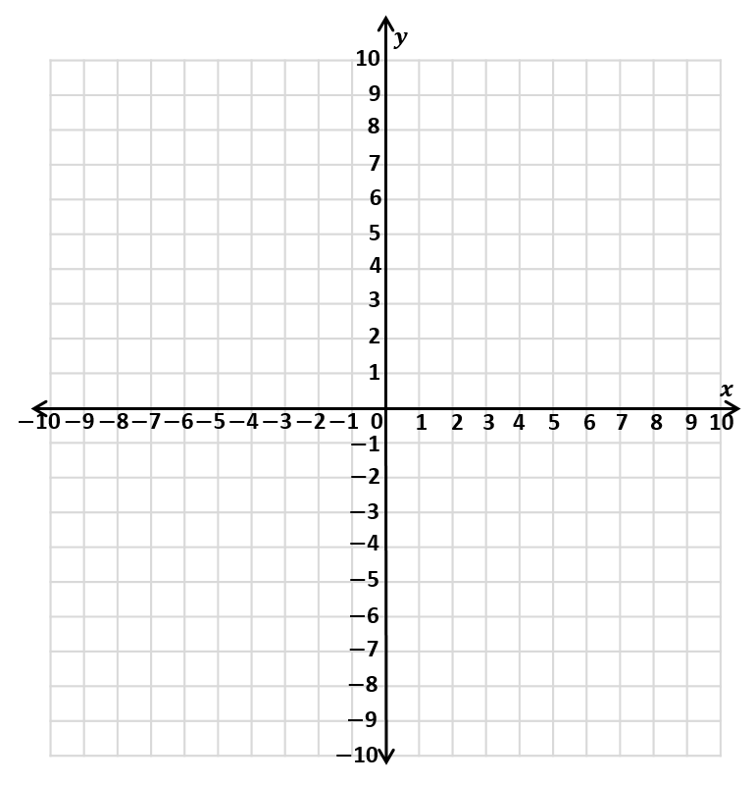
Plot the coordinates.
Draw a straight line to join each pair of coordinates.
(5, 2) (5, 7)
(3, 6) (7, 3)
(3, 3) (7, 6)
Have a think

Slide 5


(5, 2) (5, 7)
(3, 6) (7, 3)
A
(3, 3) (7, 6)
Reflect snowflake A in the $y$-axis.
Reflect snowflake A in the $x$-axis.
Translate snowflake A 10 to the left and 9 down.
What do you notice?
Have a think

Slide 6
(5, 2) (5, 7)
(3, 6) (7, 3)
A
(3, 3) (7, 6)
Reflect snowflake A in the $y$-axis.
Reflect snowflake A in the $x$-axis.
Translate snowflake A 10 to the left and 9 down.
What do you notice?
Can you create a similar question for your friend?

Slide 7
Rosie catches twice as many snowflakes as Amir.
Eva catches 5 snowflakes less than Amir.
Altogether they catch 47 snowflakes.
How many snowflakes does each person catch?
Have a think

Slide 8
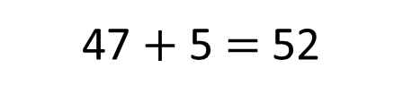

Rosie catches twice as many snowflakes as Amir.
Eva catches 5 snowflakes less than Amir.
Altogether they catch 47 snowflakes.
How many snowflakes does each person catch?
Rosie
13
13
47 $+$ 5 $=$ 52
52
Amir
52 $÷$ 4 $=$
13
47
13
Eva
8
5

Slide 9
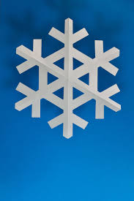
There are 28 children in Miss Rose’s class. Each child is creating
a snowflake paperchain to go around their desk.
135 cm
Have a think
81 cm
Each individual paper chain they make is 27 cm long.
How many individual paper chains are needed to decorate the perimeter of all 28 desks?

Slide 10


135 cm
Each individual paper chain they make is
27 cm long.
81 cm
27
135
162
270
1
5
6
10
Length $=$ 10 paper chains
Width $=$ 6 paper chains

Slide 11
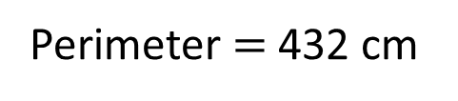


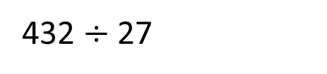
135 cm
Each individual paper chain they make is
27 cm long.
H | T | O
 | 2 | 8
 | 1 | 6
81 cm
Perimeter $=$ 432 cm
$$×$$
432 $÷$ 27
1
6
8
16 individual paper chains are needed.
2
8
0
$$+$$
How many individual paper chains are needed to decorate the perimeter of all 28 desks?
4
4
8

