Slide 1

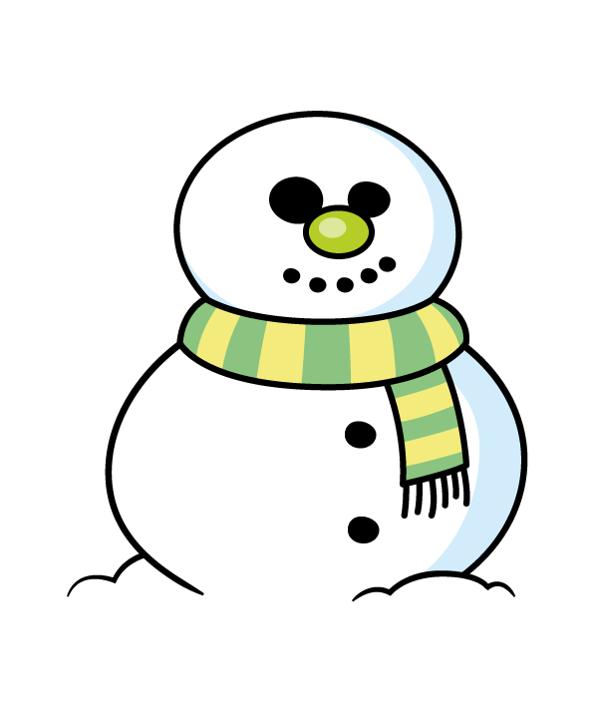

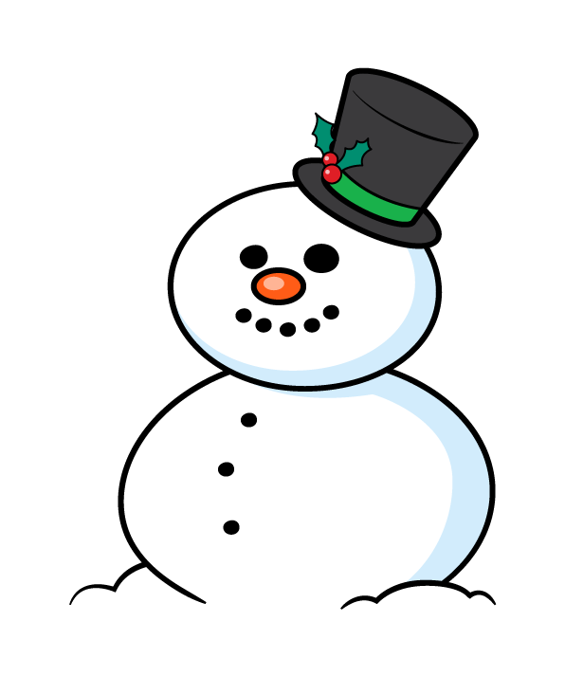



Slide 2

Snowman A
1,630 mm
Snowman B
98 cm
Snowman C
167 cm
Snowman D
One and half metres
Order the snowmen from smallest to tallest
Have a think

Slide 3
Snowman A
1,630 mm
Snowman A
163 cm
Snowman B
98 cm
Snowman C
167 cm
Snowman D
One and half metres
Snowman D
150 cm

Slide 4
Snowman A
163 cm
Snowman B
98 cm
Snowman C
167 cm
Snowman D
150 cm

Slide 5

Dora builds another snowman that becomes the third tallest.
How tall could it be?
Have a think
Any height between 150 cm and 163 cm
Snowman B
98 cm
Snowman D
150 cm
Snowman A
163 cm
Snowman C
167 cm

Slide 6
Eva’s Snowman
Ron’s Snowman
Ron builds a snowman 3 times the height of Eva’s snowman.
The height of the two snowmen altogether is 264 cm.
How tall is Ron’s snowman?
Have a think

Slide 7


Ron’s snowman is 198 cm tall.
Eva
66 cm
264 cm
Ron
66 cm
66 cm
66 cm
?
264 $÷$ 4 $=$
66 cm
66 $×$ 3 $=$
198 cm

Slide 8
Ron’s snowman is 198 cm tall.
Eva
66 cm
264 cm
Ron
66 cm
66 cm
66 cm
What is the difference in height between the two snowmen?
What if Ron’s snowman was 264 cm. How tall would Eva’s be?

Slide 9
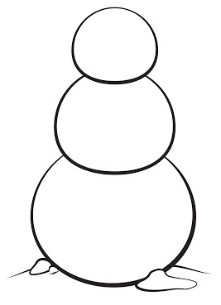




Mo has a certain amount of buttons.
Have a think
Snowman 1
Snowman 3
Snowman 2
$\frac{\text{1}}{\text{3}}$ of them are on snowman 1
How many buttons are on snowman 2 and 3?
$\frac{\text{2}}{\text{5}}$ of them are on snowman 2
$\frac{\text{4}}{\text{15}}$ of them are on snowman 3

Slide 10
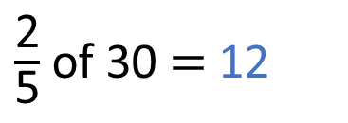
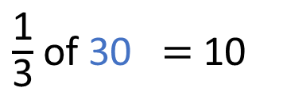



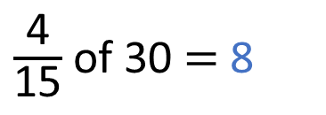
$\frac{\text{1}}{\text{3}}$ of them are on snowman 1
$\frac{\text{2}}{\text{5}}$ of them are on snowman 2
$\frac{\text{4}}{\text{15}}$ of them are on snowman 3
Snowman 1
Snowman 3
Snowman 2
?
30
$\frac{\text{1}}{\text{3}}$ of 30 $=$ 10
$\frac{\text{2}}{\text{5}}$ of 30 $=$ 12
$\frac{\text{4}}{\text{15}}$ of 30 $=$ 8
10
10
10
?

Slide 11

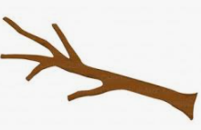



Equipment needed to decorate a snowman:
5 buttons
1 carrot
2 sticks
1 hat
1 scarf
Dexter has:
97 buttons
22 carrots
39 sticks
21 hats
20 scarves
What is the maximum amount of snowmen Dexter can fully decorate?
Have a think

Slide 12
Equipment needed to decorate a snowman:
5 buttons
1 carrot
2 sticks
1 hat
1 scarf
Dexter has:
97 buttons
22 carrots
39 sticks
21 hats
20 scarves
Snowmen | Buttons | Carrot | Sticks | Hat | Scarf
22
20
19
100
110
95
22
20
19
38
20
19
20
19
Dexter can decorate 19 snowmen.

Slide 13
Equipment needed to decorate a snowman:
5 buttons
1 carrot
2 sticks
1 hat
1 scarf
Dexter has:
97 buttons
22 carrots
39 sticks
21 hats
20 scarves
How much more of each equipment will Dexter need to decorate 20 snowmen?
How much more of each equipment will Dexter need to decorate 30 snowmen?
Snowmen | Buttons | Carrot | Sticks | Hat | Scarf
How much more of each equipment will Dexter need to decorate 100 snowmen?
19
95
19
38
19
19
Dexter can decorate 19 snowmen.

