Slide 1


New Curriculum and assessment overview
Helen Corah
Assessment Coordinator
October 2016

Slide 2

New Primary Curriculum
Statutory for most year groups from September 2014.
Our current Year 3 have experienced Y1 and Y2 of new curriculum and so are the first cohort with no “gaps”.
The bar has been raised…
There are changes in content and expectations.

Slide 3
A brief history of … The National Curriculum
1988 Last National Curriculum introduced including Levels
(only as end of Key Stage Benchmarks)
1990 National Testing - SATs for 7 year olds
1994 - SATs for 11 year olds
Sub levels developed (4c, 4b, 4a)
Push to improve 4 → 4b → 5 → 6 (equivalent to GCSE grade D)
End result = huge spread of ability and not all “secondary ready”

Slide 4
Why have the Government said that the National Curriculum needed to change?
First and foremost to raise standards.
UK seen to be falling behind other countries.
To be slimmed down… Research has shown the need to cover fewer things in greater depth.
Previous curriculum very content heavy – research has shown the need to return to the fundamental content.
Issues with the level system

Slide 5


Children missing the boat
Notes:
Analogy of children who didn’t reach a level being thrown a lifeboat and supported at their level with differentiated work, additional adult help to consolidate before moving onto higher levels.
Whilst rest steamed ahead in race for higher levels. Gap widens and it becomes impossible to catch up.

Slide 6
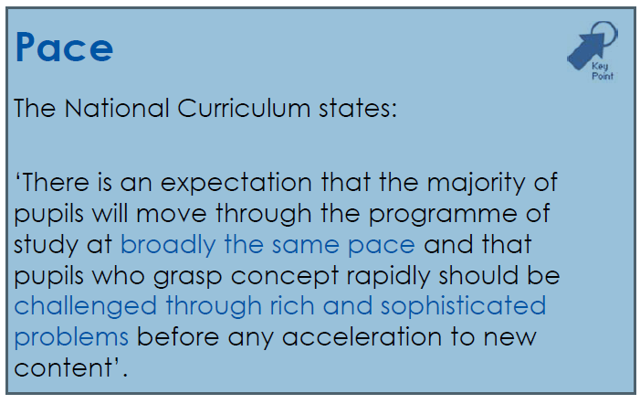

Mind the gap!
Notes:
Even HA racing through from one level to next to make most rapid progress had missing gaps as levels were best fit, causing more and more problems later.

Slide 7
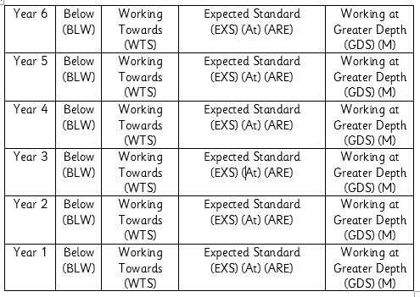
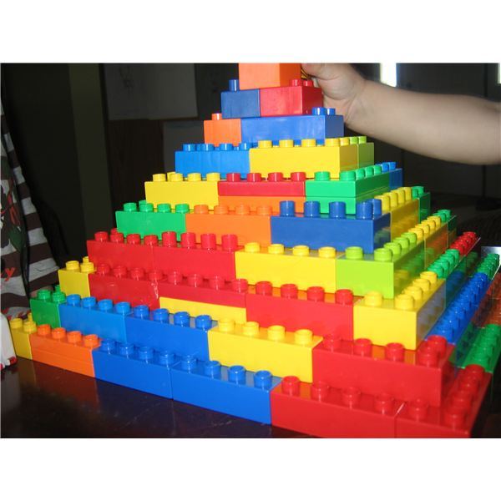
Deep and secure learning for all!
Notes:
Practice, consolidation → fluency and security of learning
HA extend depth, breadth and making connections

Slide 8
Also known as The Deeper Learning Model
Working at a greater depth within the National Standard
GDS
BLW
W1
W2
W3
ARE

Slide 9



What do we mean by the core subjects?
English
Spoken language
Writing
Reading
Spelling, vocabulary, grammar and punctuation (SPAG).
Maths
Number and place value
Addition, subtraction, multiplication and division.
Fractions
Measurement
Geometry
Statistics.
Science
Working scientifically,
Plants, animals (including humans),
Rocks,
Light,
Forces and magnets,
States of matter,
Electricity,
Properties and changes of materials,
Earth and Space,
Evolution and inheritance (Y6)

Slide 10
Some of The main changes…
English
Stronger emphasis on vocabulary development, grammar, punctuation and spelling (for example, the use of commas, apostrophes and capitalising proper nouns will be taught in KS1)
Spelling word lists are included for Key Stage 2.
Handwriting –is expected to be fluent, legible and speedy
Spoken English has a greater emphasis, with children to be taught debating, recitation and presenting skills.
Strengthen the teaching of phonics - more pupils should read fluently.
Emphasis on reading more widely, for pleasure.

Slide 11
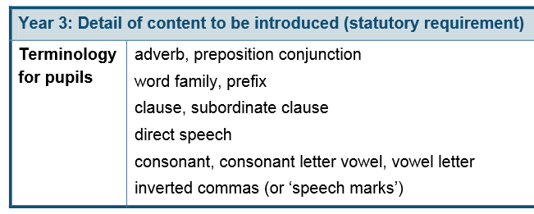
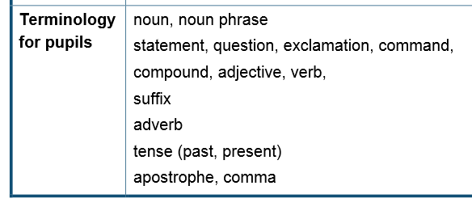
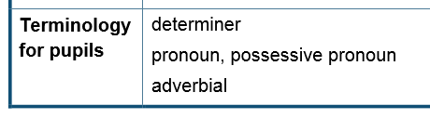
Grammatical terms pupils should recognise, use and practise
Year 2: Detail of content to be introduced (statutory requirement)
Year 4: Detail of content to be introduced (statutory requirement)
Notes:
Terms in bold

Slide 12
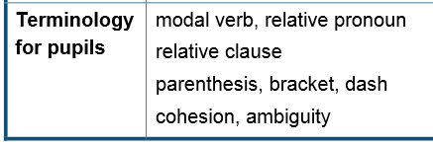
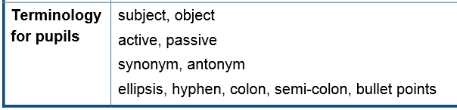
Grammatical terms pupils should recognise, use and practise
Year 5: Detail of content to be introduced (statutory requirement)
Year 6: Detail of content to be introduced (statutory requirement)
Notes:
Terms in bold

Slide 13
Some of The main changes…
Mathematics
It goes beyond the previous curriculum.
Need to keep key maths fundamentals, such as times tables and number facts, "on the boil“ (All times tables and related division facts up to 12 x 12 known by Y4)
Emphasis on calculating and problem solving with fractions and decimals and less on data handling (now called statistics).
Calculators are banned in the KS2 SAT. There is an increased emphasis on mental fluency and the use of efficient written methods in the four mathematical operations.
Notes:
There's quite a lot of new content which, up until now, has been regarded as the province of ‘secondary maths’. This includes long division at year 6, and an increasingly complex understanding of fractions and decimals. Some content has moved ‘down’ by one or two years, meaning children will be expected to master some things earlier than they have before.

Slide 14
Content now in KS1 that used to be Year 3
Use numbers and images to find a solution and present it in context, where appropriate using £.p notation or units of measure
Derive and recall all addition and subtraction facts for each number to 20, sums and differences of multiples of 10 and number pairs that total 100
Derive and recall multiplication facts for the 2, 5 and 10 times-tables and the corresponding division facts
Add or subtract mentally combinations of one-digit and two-digit numbers
Multiply one- and two-digit numbers by 10, and describe the effect
choose and use appropriate units to estimate, measure, and record measurements
Read scales to the nearest whole digit
Read the time on a 12-hour digital clock and to the nearest five minutes on an analogue clock; calculate time intervals and find start or end times for a given time interval

Slide 15

Notes:
Find what’s moved into Year 2 and combine

Slide 16


Slide 19
So HOW do we assess?
In school formative assessment
Questioning, marking, observations, recap quizzes, scanning work
RAG rating for each objective for each pupil on O Track (class track)
Provides on going, day to day and even within lesson monitoring of pupils’ strengths, weaknesses and next steps
Reported to parents to strengthen partnerships and aid learning
Communicated to pupils, providing targets and next steps
Acted on, in class, within the lesson, that afternoon or the next day
Shared with next teachers as shows exactly where gaps are
Notes:
Enables puils to take more responsibility for their achievements by reflecting on progress, understanding strengths and identifying what they need to do to improve.

Slide 20
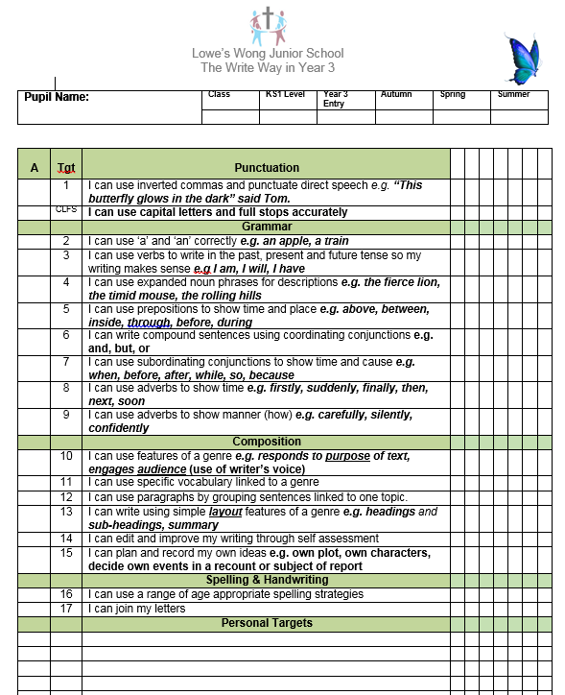

Slide 21
In school summative assessment
Termly conversion to Deeper Learning ARE (Age Related Expectation) Judgement
Use combination of termly tests, teacher assessment, in class questioning and work analysis as well as suggestion from O-Track
Produces percentages of pupils on track to achieve ARE/ good progress by end of year
Analysed to provide information on in year progress of specific groups
Used to identify need for interventions
Information from this will inform parents’ meetings discussions and reports, plus informal meetings

Slide 22
End of Year Reports
Communicate level of success at objectives for that Year group
Clear next steps
Overall rating of Below, W1, W2, W3, ARE or GDS for each core subject
Remember
Achieving ARE constitutes good attainment due to the challenge built into the curriculum

Slide 23
Conversion from levels to ARE
Has been a sticking plaster moment
We have converted all KS1 levels, Y3 entry levels and July 2015 levels to ARE in order to track progress
Perceived lack of progress has become apparent as more information of Expected Standards was released last year (especially at Greater Depth)
NB New standardised and externally analysed Year 3 Entry tests are being administered and external Writing Moderation sought to provide us with a watertight Year 3 Entry ARE/ baseline
Diagnostic NVR tests will still be carried out on all pupils

Slide 24
“The new standards were designed to be broadly similar, but are not equivalent, to an old level 4b. The performance descriptors, used by teachers in the standard setting process, were developed with an understanding of the performance of pupils working at a 4b. However, given the curricula differences, there is not a direct equivalence between the new expected standard and level 4b in previous years.”
Department for Education
National curriculum assessments at key stage 2 in England, 2016 (provisional)

Slide 25
Year 6 Results 2016
Nationally, in 2016, 53% reached the Expected Standard in reading, writing and mathematics
Nationally, in 2015, 80% achieved level 4 or above in reading, writing and mathematics (69% achieved a 4b in reading and maths and a 4 in writing)
At LWJ, in 2016, 72.5% reached the Expected Standard in reading, writing and mathematics
At LWJ, in 2015, 87% achieved level 4 or above in reading, writing and mathematics (80% achieved a 4b in reading and maths and a 4 in writing)

Slide 26
Attaining a higher standard (GDS)
Nationally, in 2016, 5% reached the Higher Standard in reading, writing and mathematics
“A threshold on the scaled score of 110 was chosen to give approximately one-fifth of pupils achieving the high score in each subject.” (DfE)
At LWJ, in 2016, 6% reached the Higher Standard in reading, writing and mathematics
At LWJ, in 2015, 37% achieved level 5 or above in reading, writing and mathematics
And Level 6: 11% Maths (9%), SPAG 11% (4%), Reading 2% (Nat 0%)

Slide 27
Further information
Parents’ Evenings
Website
Any Questions?

